Slide 1
ELEMENTARY STATISTICS, BLUMAN
Experimental Design
© 2019 McGraw-Hill Education. All rights reserved. Authorized only for instructor use in the classroom. No reproduction or further distribution permitted without the prior written consent of McGraw-Hill Education.

Slide 2
Objectives for this PowerPoint
Recognize, and understand the advantages and disadvantages of, an observational study.
Recognize, and understand the advantages and disadvantages of, an experimental study.

Slide 3
Observational Study
The researcher merely observes what is happening or what has happened in the past and tries to draw conclusions based on these observations.

Slide 4
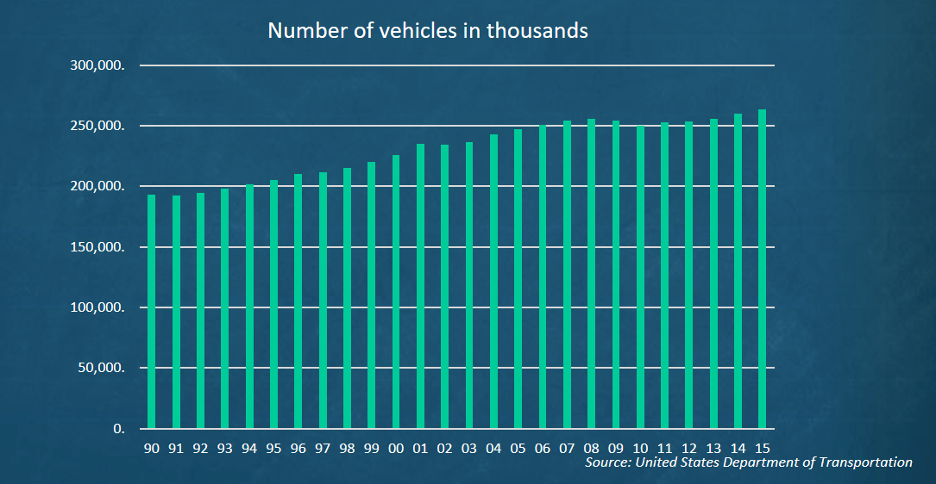
Example of Observational Study
If a researcher looks at the number of registered vehicles in the US from the years 1990 through 2015. Then the researcher is merely looking at a historical data set. There is no intervention by the researcher in the process of gathering and reporting this data.

Slide 5
Advantages of Observational Study
Observational studies are typically carried out in a natural setting.
Observational studies can be carried out in situations where intervention by the researcher would be considered unethical or even dangerous such as in the case of crime statistics.
Observational studies can be done using variables where manipulation is impossible such as studies involving height, age, and race.

Slide 6
Disadvantages of Observational Study
A definite cause and effect relationship cannot be shown since the researcher cannot manipulate other influencing variables.
The research is subject to the inaccuracies of other data gatherers such as in the case of historical data like crime statistics from the 1800s or health statistics from another country.

Slide 7
Experimental Study
The researcher manipulates one of the variables and tries to determine how the manipulation influences other variables.

Slide 8
Example of Experimental Study
When a pharmaceutical company tests the side effects for experimental medications they will administer a placebo to a control group and the actual medical therapy to the treatment group. They would then compare to see if a statistical significance exists between the incidents of a side effect between the two groups.
 | Control Group | Treatment Group
Cranial Diminution | 2.2% | 5.3%
Digital Curvature | 3.8% | 4.2%

Slide 9
Advantages of Experimental Study
The researcher can decide how to select subjects and assign them to groups such as control and treatment groups.
The researcher can manipulate variables such as dosages in medical studies.

Slide 10
Summary
In this PowerPoint we learned the following:
Recognize, and understand the advantages and disadvantages of, an observational study.
Recognize, and understand the advantages and disadvantages of, an experimental study.

